Slide 1
Navigating Flood Risks: Putting River Gauge Data from the National Water Prediction Service to Use
Juvare User Conference – Orlando 2025
Ciprian Sufitchi – Fortechnics LLC, NCR WebEOC Support

Slide 2
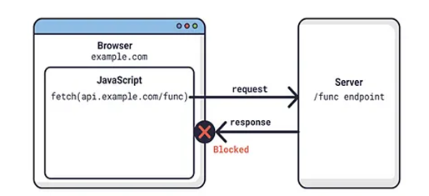
API Access from WebEOC Boards
Same-origin policy (SOP)
Cross-Origin Resource Sharing (CORS)
Most APIs do have CORS enabled
API Server must send CORS header
Access-Control-Allow-Origin: http://example.com
Access-Control-Allow-Origin: *

Slide 3
A Simple Webhook Approach
Concept: use a server to submit requests to API
Server is under our control
CORS header could be customized
WebEOC view
Request (JS)
AWS server
(processing request and response)
Request (PHP)
National Water Prediction Service API
Response (JS)
Response (JSON)
Access-Control-Allow-Origin: *

Slide 4
A Simple Webhook Approach
JS code as global board resource
webhook.js
var webhook = {
getData: function(id, param) {
return $.ajax({
type: "POST",
data: {id:id, param:param},
async: true,
url: "https://aws.eoccloud.com/webhook/webhook.php",
success: function(data) {
//console.log(data);
},
error: function() {
console.log('Error occured');
}
}).done(function(d) {
});
}
}

Slide 5
A Simple Webhook Approach
Display View (List)
<script type="text/javascript" boardresource="webhook.js"></script>
Example to get River Gauge “lrgv2 “ data from National Water Prediction Service API :
var arr = [“lrgv2”];
var id = 99;
$.when(webhook.getData(id, arr)).done(function(data) {
console.log(data);
/*
Do something with data
*/
});

Slide 6
A Simple Webhook Approach
AWS web server code (webhook.php)
<?php
header("Access-Control-Allow-Origin: *");
switch ($_REQUEST["id"]) {
case 1:
/* other implementation */
break;
case 99:
// National Water Prediction Service API
$base_url = https://api.water.noaa.gov/nwps/v1/gauges/;
$param = $_REQUEST["param"];
$gid = $param[0];
$json = file_get_contents($base_url.$gid);
/* implementation */
$jout = json_encode($out);
header('Content-Type: application/json; charset=utf-8');
echo($jout);
break;
default:
die();
}
?>

Slide 7
National Water Prediction Service API
Documentation: https://api.water.noaa.gov/nwps/v1/docs/
​/nwps​/v1​/gauges​/{identifier} Gets a gauge and it's metadata.
To get current level + other information
​/nwps​/v1​/gauges​/{identifier}​/stageflow​/observed Gets observed or forecast stage/flow product data for a gauge.
To get past values, to calculate the trend

Slide 8
River Gauges Board
List View
Retrieve values once every 10 seconds
Function to capture gids from each row
<script type="text/javascript" boardresource="webhook.js"></script>
setInterval(function(){
getNOAAdata();
}, 10000);
function getNOAAdata() {
$.each($('.gids'), function (index, val) {
getDataAPI(val.innerText);
});
}

Slide 9
River Gauges Board
Get information from API and display it
function getDataAPI(gid) {
var arr =[gid];
$.when(webhook.getData(1, arr).done(function(o) {
/* o is a JSON object */
var currentLevel = o.currentLevel;
var floodLevel = o.floodLevel;
var actionLevel = o.actionLevel;
var moderateLevel = o.moderateLevel;
var majorLevel = o.majorLevel;
var previousLevel = o.previousLevel;
/* populate list view’s table with values, colors etc. */
$("#" + gid).html(currentLevel + "' ");
// optional: add a chart
$("#G"+gid).attr('src’, 'https://water.weather.gov/resources/hydrographs/’ + gid + '_hg.png ');
}

Slide 10
River Gauges Board
But wait, National Water Prediction Service API has CORS header enabled!
No intermediary AWS server is required in this case
Javascript code is able to retrieve directly JSON from API
Two calls should be performed for each sensor
Current status
Previous status

Slide 11
River Gauges Board
Code sample (“List JS” view):
$.each($('.gids'), function (index, val) {
var gid = val.innerText;
var aa =[gid];
fetch('https://api.water.noaa.gov/nwps/v1/gauges/'+gid)
.then(response =&gt; response.json())
.then(function(data) {
console.log(data);
var currentLevel = data.status.observed.primary;
var floodLevel = data.flood.categories.minor.stage;
var actionLevel = data.flood.categories.action.stage;
var moderateLevel = data.flood.categories.moderate.stage;
/* more implementation */
});
});

Slide 12
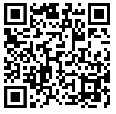
Conclusions
The “simple webhook” approach allows access to any external API
National Water Prediction Service API can be accessed directly from the board (optional)
A Design Studio board “River Gauges (Orlando)” is available at this URL: https://www.ncrwebeoc.com/downloads/boards/River-Gauges-Orlando.zip

Slide 13
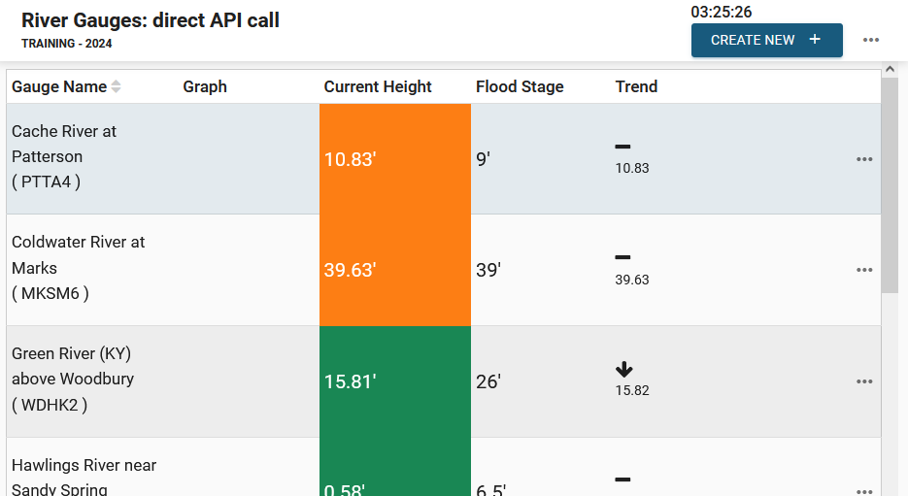
Board Demo

Slide 14
Thank you!
Questions?

